Slide 1
European Coordination Committee on Human Rights Documentation
20-21 April 2017 Venice

Slide 2
Who we are
HURIDOCS is a Geneva-based international NGO founded in 1982
We help human rights communities to improve their information management systems, strategies and practices
Active globally with local partners
Areas of expertise: human rights documentation, case law management, human rights data management, digital security.
<number>

Slide 3
Why does it matter?
More efficient work
Quick access to important information
Richer analysis and better-informed advocacy and litigation
Share knowledge and information about human rights
Prevent loss of valuable information
<number>

Slide 4
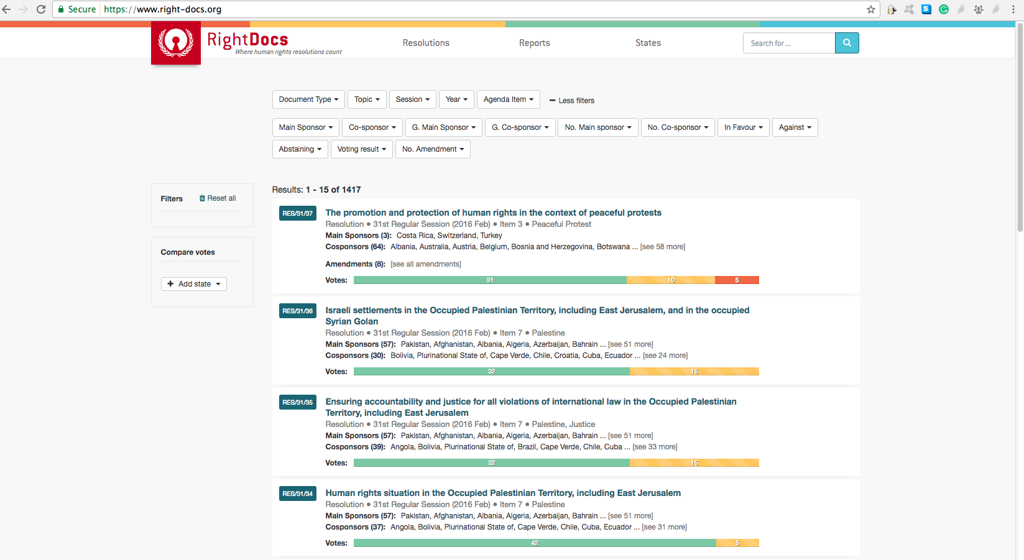
RightDocs

Slide 5
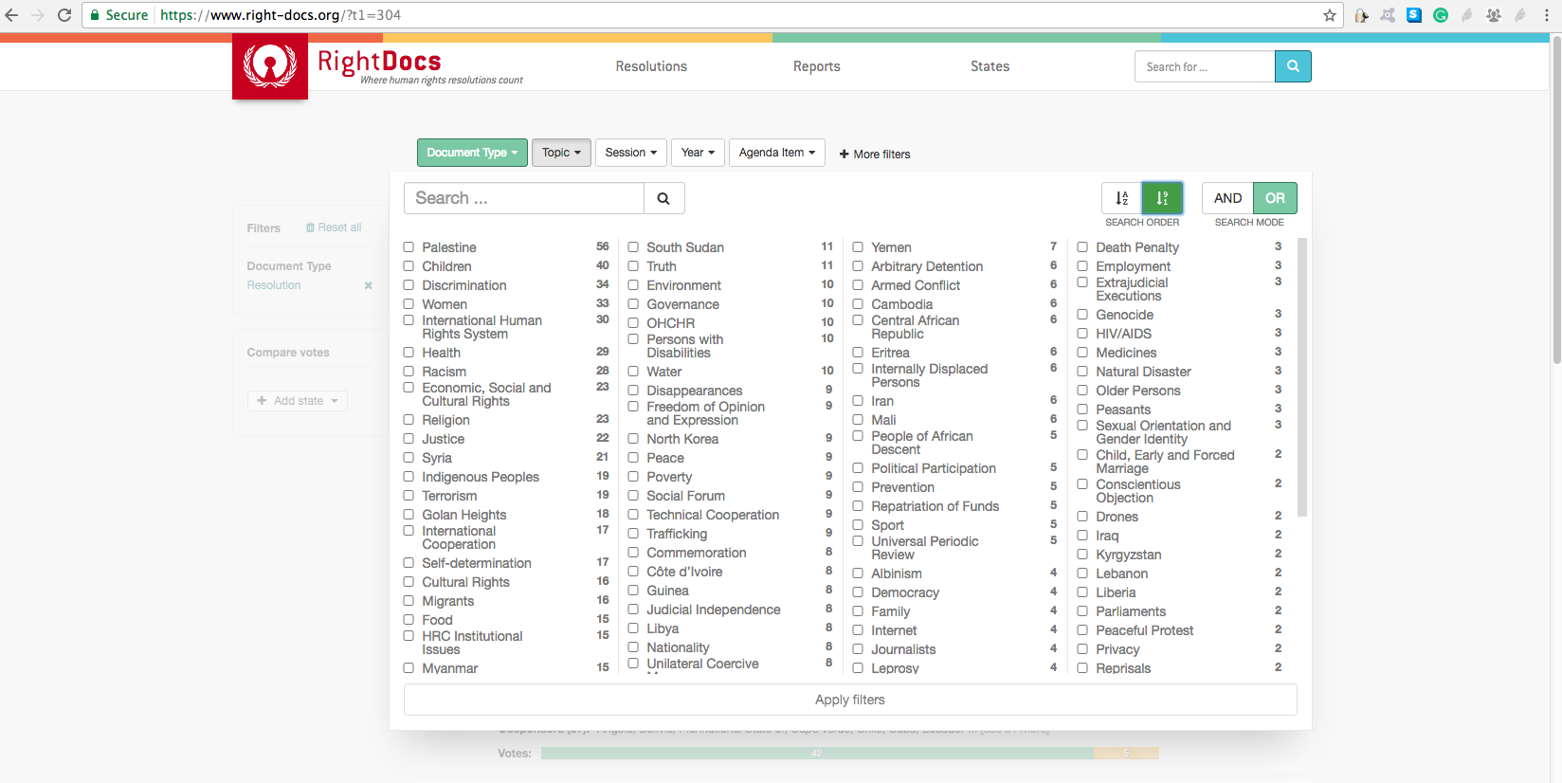
RightDocs: UN Human Rights Council resolutions

Slide 6
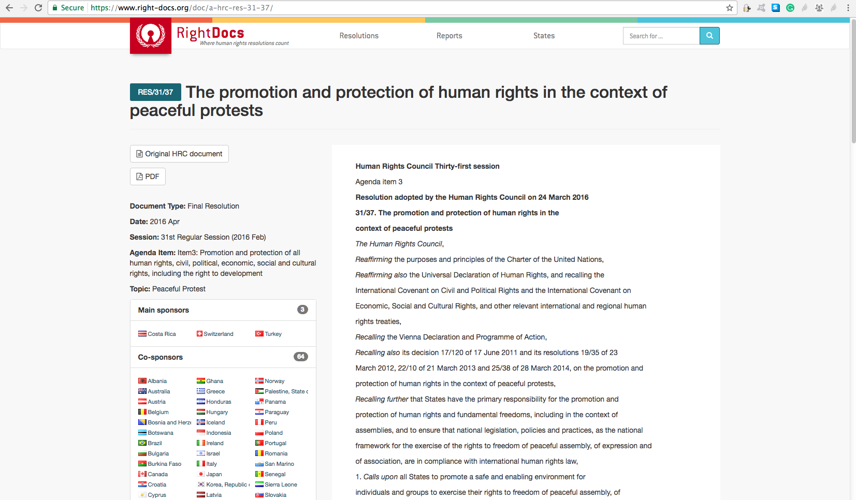
RightDocs: UN Human Rights Council resolutions

Slide 7
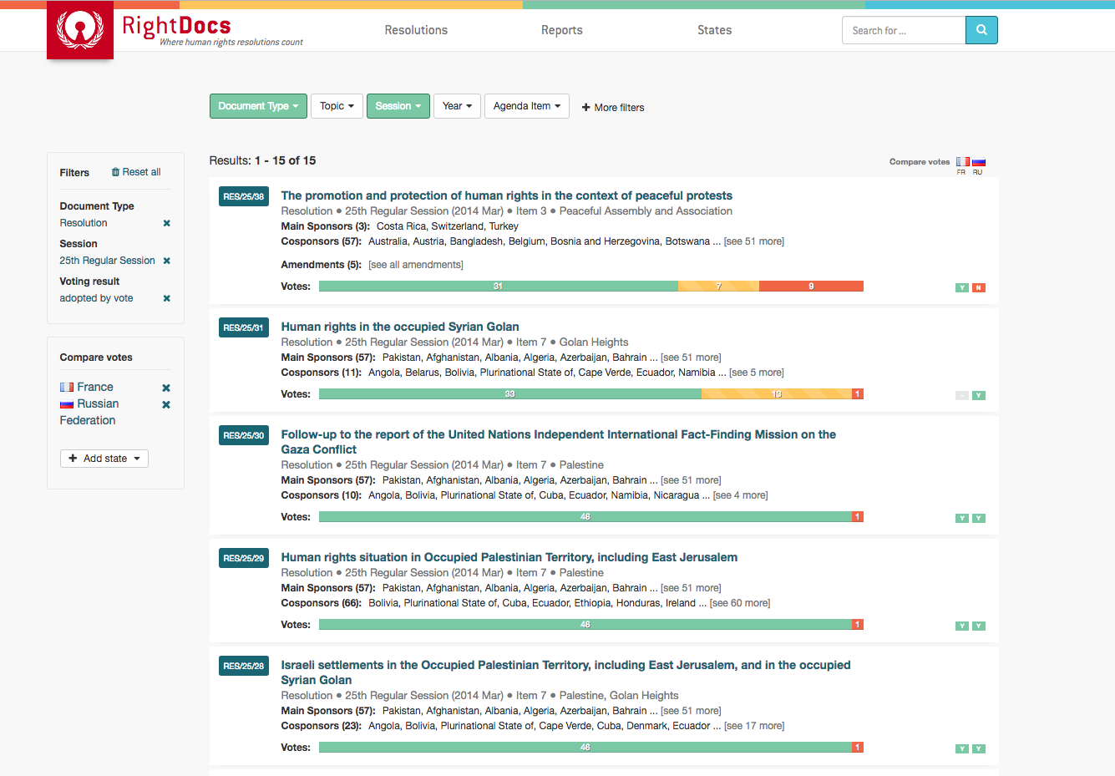
RightDocs: compare UN Human Rights Council votes

Slide 8
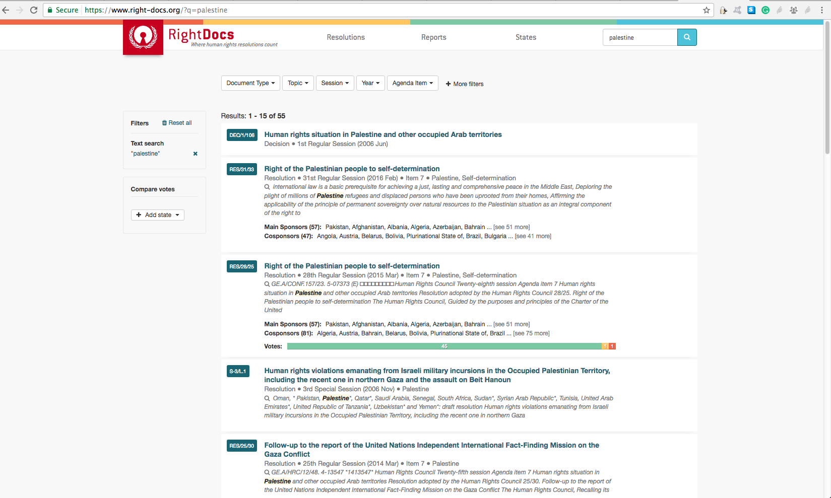
RightDocs: full text search UN Human Rights Council

Slide 9
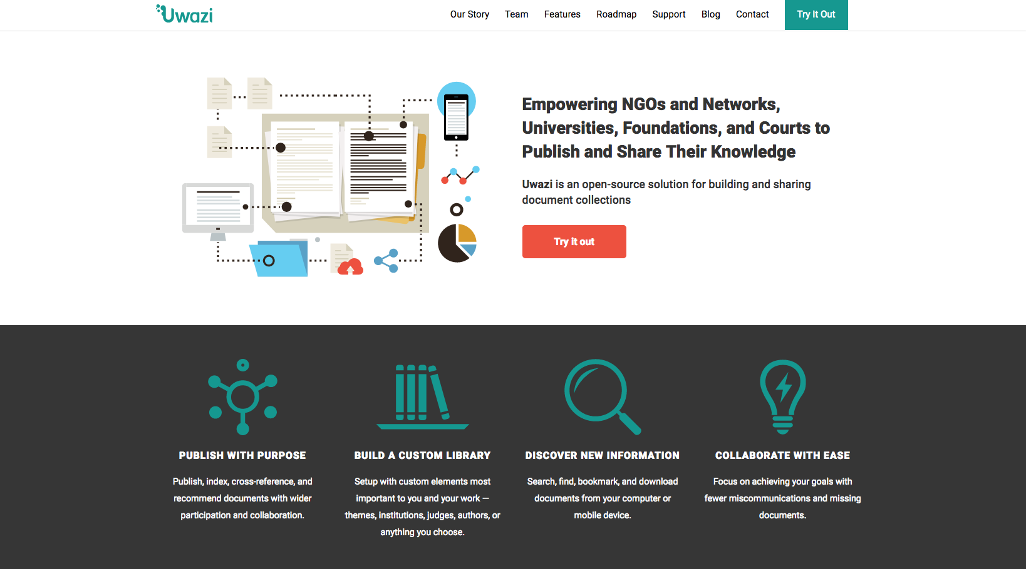
Uwazi: www.uwazi.io

Slide 10
Uwazi demo: human rights reports
https://hr-reports.uwazi.io/en/

Slide 11
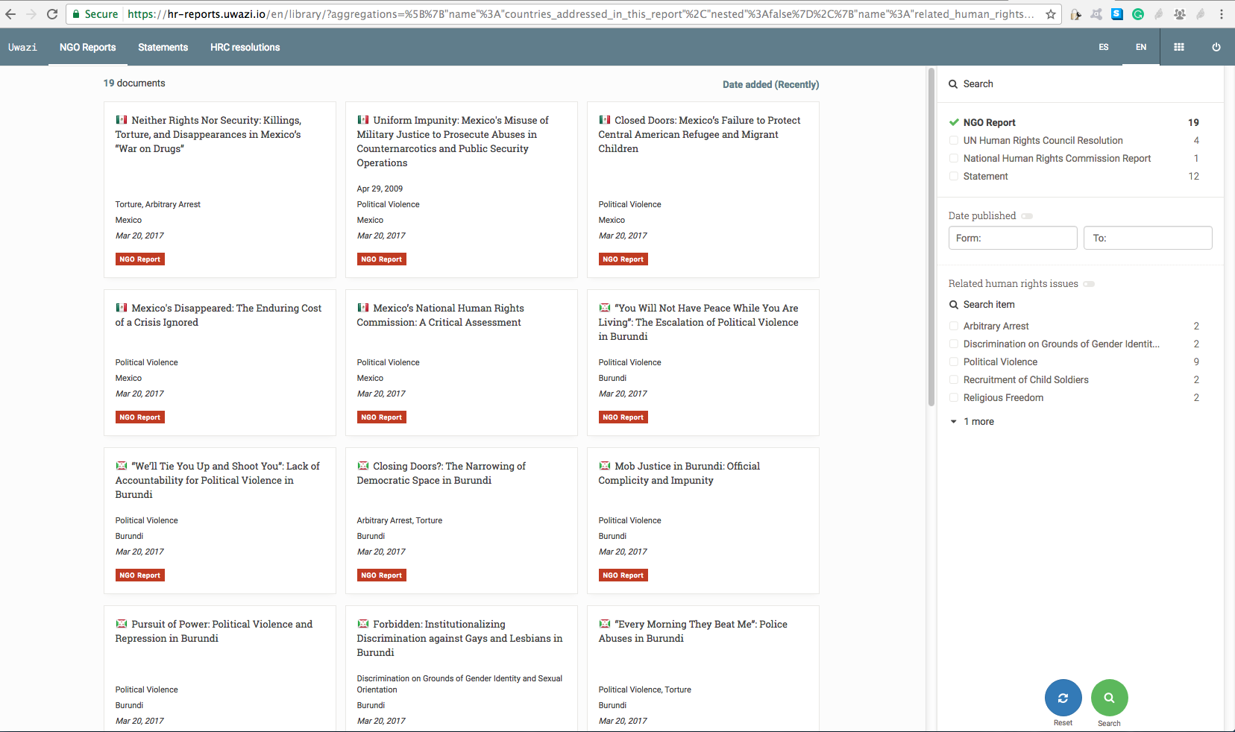
Uwazi: online library for publishing and collaborating on documents

Slide 12
Uwazi: online library for publishing and collaborating on documents

Slide 13
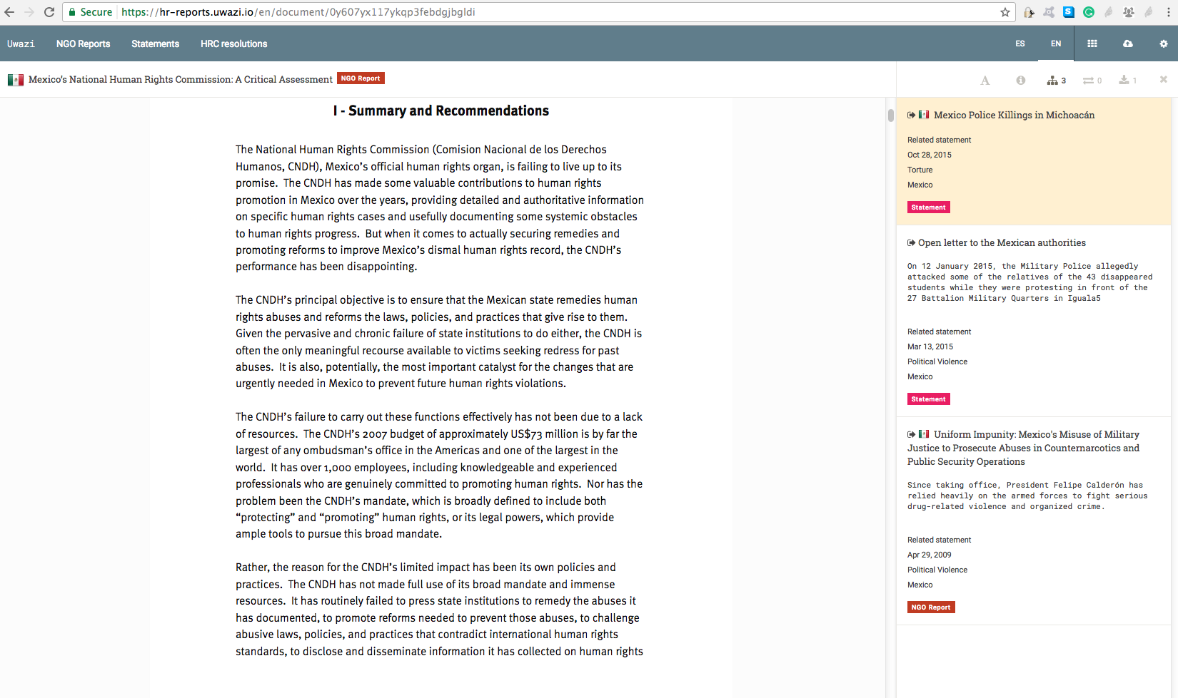
Uwazi: make references and collaborate on documents

Slide 14
HURIDOCS Collaboratory

Slide 15
HURIDOCS Collaboratory
Online community of practitioners: Collaboratory:
Exchange expertise and seek advice
Connect and build an online network
Benefit from webinars and contribute to online discussions
Join Collaboratory: https://collaboratory.huridocs.org/

Slide 16
Thank you
Contact me:
manushak@huridocs.org
Visit us: www.huridocs.org
Follow us: @HURIDOCS

