Slide 1
Update on the
HUDOC database
Stefano Palermiti
Head of Hudoc
38th Meeting of the European Coordination Committee
on Human Rights Documentation
Venice, Italy
20th – 21st April2017

Slide 2
Hudoc at a glance
3,8M+ visitors in 2016
Total # of documents as of April 2017
  136K+ (7% increase vs last year)
NOL translations
  21,4K+ as of April 2017 (+22% y/y)
  ~16% of whole DB
NOL interfaces
  Currently 2 (TUR Nov 2013, RUS Apr 2014)

Slide 3
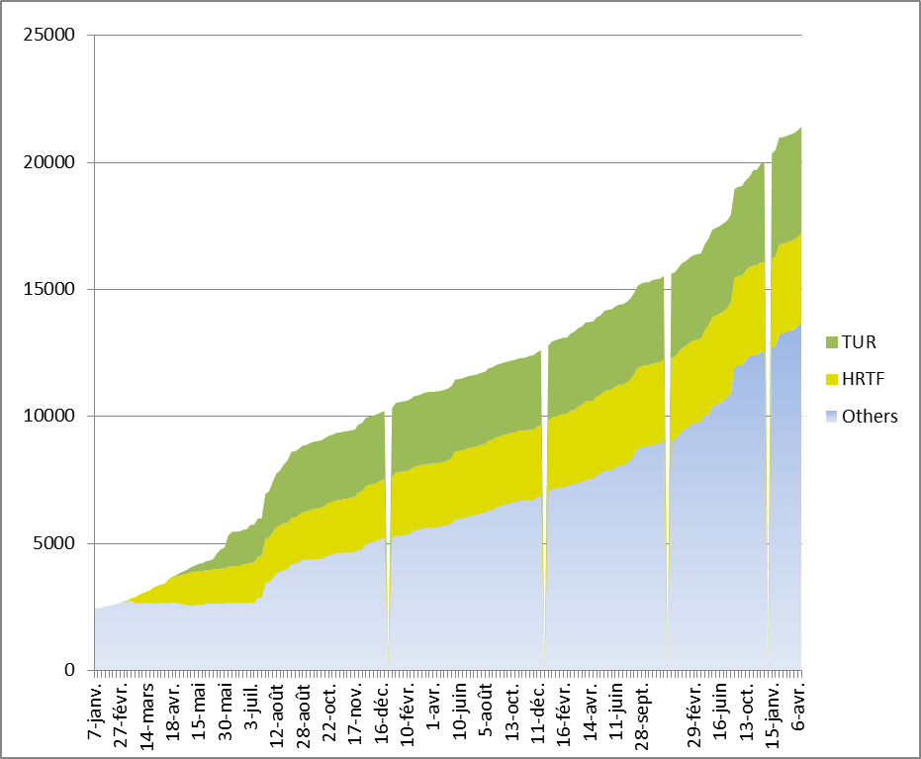
NOL Translations

Slide 4
Hudoc next steps
Future NOL interfaces
  Spanish 2017
  Georgian
  Bulgarian
  Ukrainian
  More…

Slide 5
Hudoc next steps
Phase 4
  Unified Search - across the HUDOC collections
  Improved Spell Checking - Done
  Improved Filters (NOT lookup, Document Definition filter, Hide metadata only docs) - Done
  Topics/Concepts – POC
  Pending translations

Slide 6
Other ECHR case-law tools
Reports of Judgments and Decisions (Official series)
Case-Law Information Note
Admissibility guide
Case-law guides
Case-law research reports
Factsheets
Country profiles
@ECHRPublication twitter account

Slide 7
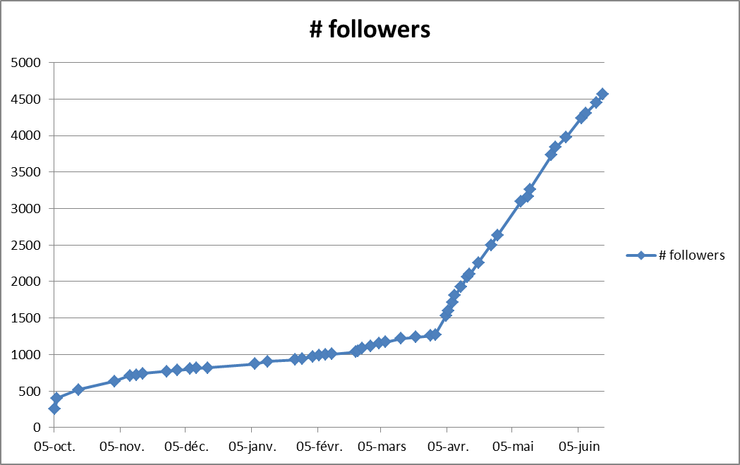
Twitter followers
(as of june 2016)
@ECHRPublication

Slide 8
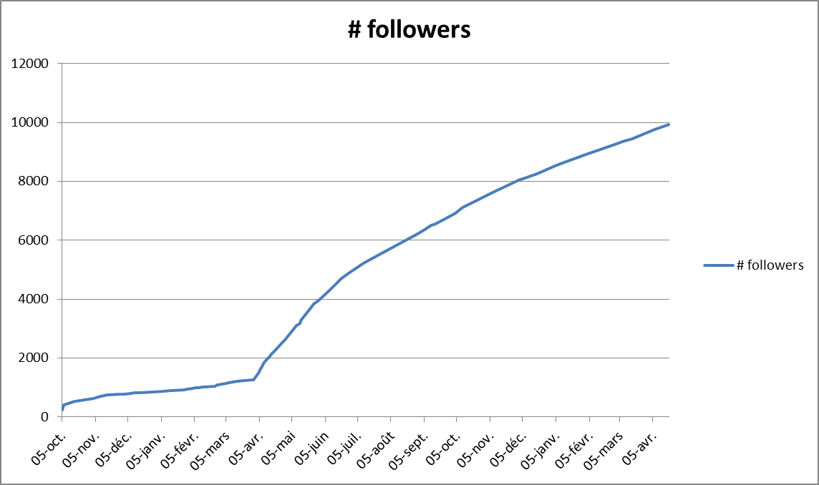
Twitter followers
(as of april 2017)
@ECHRPublication

Slide 9
Questions ?
For any further information
Stefano.palermiti@echr.coe.int

